Slide 1


NATIONAL INSTITUTE OF TECHNOLOGY, WARANGAL
PROJECT WORK
ON
DATABASE MANAGEMENT SYSTEM
Prepared By:-
Pranav Ghante 21CSB0A75
Ishaan Agrawal 21CSB0F14

Slide 2


PROJECT TITLE:-
PROPERTY AND REAL ESTATE
MANAGEMENT

Slide 3
PROBLEM STATEMENT:-
Any job that requires immeasurable time and resource to be invested is undoubtedly cumbersome and if a lot of factors need to be considered on top of that then it becomes tiresome and may lead to produce less accurate and inefficient outputs. One of such tasks is ‘Property Management’. Managing a property in today’s world is indeed a hectic and a responsible task. Numerous properties can be available for sale or on rent, which have a particular type viz ‘Industrial’ , ‘Commercial’ and ‘Residential’, the cost associated, and their staged location. Managing multiple properties without maintaining proper records or using file storage may lead to data inaccuracy and anomalies and also reduces the efficiency as it becomes time consuming, complex because property can be located in different geographic locations. Another major issue is created when the property to be bought is not inspected and the requirements requested by the client is not fulfilled which leads to troubles in the future and lack of customer trust. These are some of the challenges of Property Management.
Here, we bring a Property and Real Estate Management System that helps solve numerous challenges associated with managing a property. First and foremost, it helps the real estate agency to keep record of the properties, their locations, price, name of the owner and other attributes in a manner that avoids anomalies and ensures efficient procuring when needed. It ensures providing clients with properties which are , if available, according to their requirements and also provides Assessing as well as Inspection services to the property owners to have a record of status of property and its actual sale or rent cost based on its condition. There exists an entity which provides an image of the property to guarantee it physical existence. This solves some of the problems associated with Property Management

Slide 4
ENTITIES IN ER MODEL:-
The following are the entities in the below shown ER Model along with the attributes associated with them.
a) Property:-
It is a strong entity that consists of the following attributes:
Prop_id, Prop_Type, Status, Area, Price, Buy/Rent, and a Composite Attribute Address(Pin_Code, State, City).
b) Client:-
It is a strong entity having single-valued attributes Client_id, Client_name, Preferred_Location and a
Multivalued attribute Phone_no.
It also has IS A relationship with two entities, Buyer and Tenant

Slide 5
c) Property_Inspection_Officer:-
It is a strong entity and having all single valued attributes:
PIO_id, PIO_name, Phone_no, License_no.
d) Assessor:-
It is a strong entity having all single valued attributes: A_id, A_name, Phone_no, License_no, E-mail
e) Agent:-
It is a strong entity having Agent_id, Agent_name, Phone_no as Single valued attribute and Agent_Email as Multivalued attribute.

Slide 6
f) Contract:-
It is a strong entity having all single valued attributes C_id, C_date, S_date, E_date, Contract_value.
g) Appointment:-
It is a strong entity having single valued attributes Ap_date, Ap_id
h) Property_Services:-
It is a strong entity composed of single valued attributes
Service_id, Service_date, Service_type
i) Buyer:-
A strong entity having B_req and Budget attributes

Slide 7
j) Tenant:-
A strong entity having T_req, Rent and Num_Inmates attributes
k) Property_Image:-
A weak entity having a discriminated attribute Img_id and two single valued attributes Img_name and Descp. It has ‘has’ relationship type with Property entity and has total participation.
l) Property_Owner:-
A strong entity consisting of single valued attributes Owner_id, Address, Phone_no and Composite Attribute Owner_name(First_Name, Last_Name).

Slide 8
ASSUMPTIONS OF ER MODEL
· A property owner can own multiple properties, each unique property associated with one owner only.
· A property service is associated with multiple properties and each property can be associated with a single property service.
· An agent can be acquainted with multiple properties and each property is associated with one agent only.
· Property_Image entity exists only when Property entity exists, hence is a weak entity and involves total participation.
· A property owner can request multiple property services and each property service is associated with one property owner only.
· A property inspection officer can handle multiple property services and each property service is unique and handled by one property inspection officer only.
· An assessor can handle multiple property services and each property service is unique to an assessor.
· A client requests only one appointment with the agent. However, an agent can respond to many clients’ appointments.
· A client signs only one contract, each unique to the client.
· An agent manages multiple contracts, each specific to an agent.

Slide 9
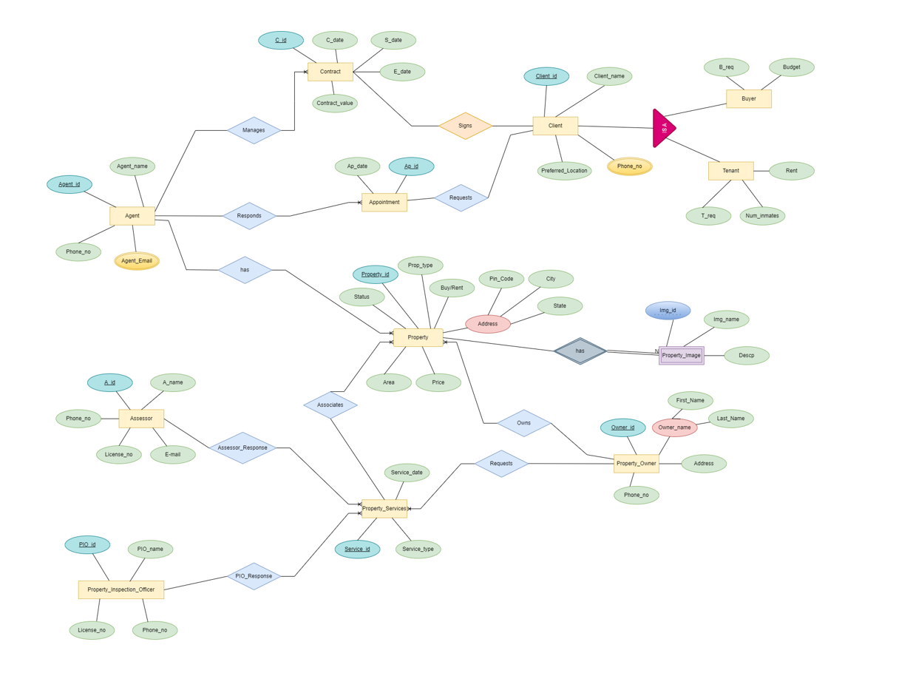
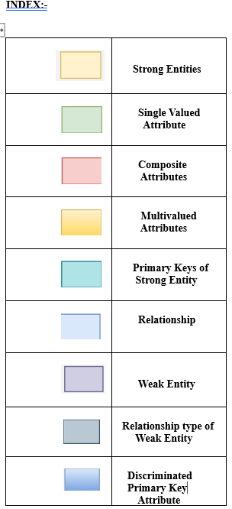

ENTITY RELATIONSHIP MODEL

Slide 10
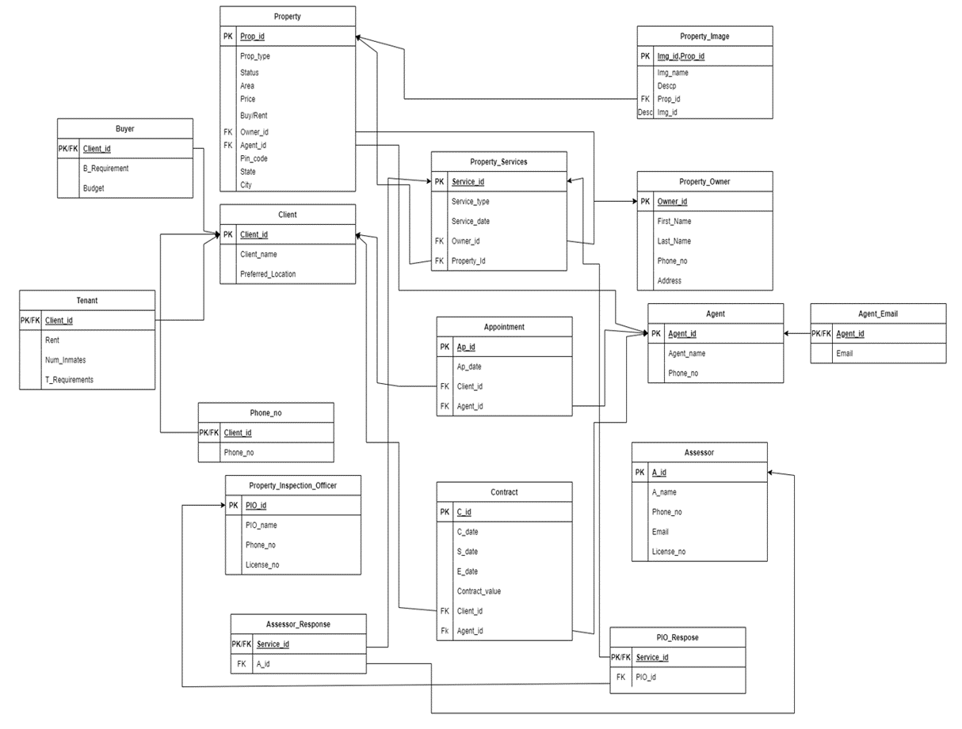
RELATIONAL SCHEMA: BEFORE NORMALIZATION

Slide 11
FUNCTIONAL DEPENDENCIES AND PRIMARY KEY OF EACH ENTITY
· Property:-
Prop_id->{Prop_type,status,Area,Price,Buy/Rent,Owner_id,Agent_id,Address}
Pin_code - > State,City
Since all the attributes depend on Prop_id, (Prop_id)⁺-> All Attributes
Therefore Prop_id is the Primary key
· Buyer:-
Client_id -> {B_Requirement,Budget}
Since all the attributes depend on Client_id, (Client_id)⁺-> All Attributes
Hence Client_id is the Primary Key

Slide 12
· Tenant:-
Client_id->{Rent,Num_inmates,T_Requirements}
Since all the attributes depend on Client_id, (Client_id)⁺-> All Attributes, Hence Client_id is the Primary Key
· Client:-
Client_id->{Client_name,State,City,Pin_Code,Preferred_location}
Pin_code -> City
Since all the attributes depend on Client_id, (Client_id)⁺-> All Attributes, Hence Client_id is the Primary Key
· PIO_Response:-
Service_id -> {Service_id, PIO_id}
Since all the attributes depend on Service_id, (Service_id)⁺ -> All Attributes Hence Service_id is the Primary Key

Slide 13
· C_Phone_no:-
Client_id->{Phone_no}
Since all the attributes depend on Client_id, (Client_id)⁺-> All Attributes
Hence Client_id is the Primary Key
· Property_Inspector_Officer:-
PIO_id ->{PIO_name,Phone_no,License_no}
License_no -> {PIO_name,Phone_no}
Since all the attributes depend on PIO_id, (PIO_id)⁺-> All Attributes
Hence PIO_id is the Primary Key

Slide 14
· ·Assessor_Response:-
Service_id -> {A_id}
Since all the attributes depend on Service_id, (Service_id)⁺-> All Attributes
Hence Service_id is the Primary Key
·Property_Services:-
Service_id -> {Service_type, Service_date, Owner_id, Property_id}
Since all the attributes depend on Service_id, (Service_id)⁺-> All Attributes
Hence Service_id is the Primary Key
· Appointment:-
Ap_id -> {Ap_id, Ap_date, Client_id, Agent_id}
Since all the attributes depend on Ap_id, (Ap_id)⁺ -> All Attributes
Hence Ap_id is the Primary Key

Slide 15
·Contract:-
C_id -> {C_id, C_date, S_date, E_date, Contract_value, Client_id, Agent_id}
Since all the attributes depend on C_id, (C_id)⁺ -> All Attributes, Hence C_id is the Primary Key
· Property_Image:-
Img_id,Prop_id -> {Img_id, Prop_id, Img_name, Descp}
Since all the attributes depend on Img_id,Prop_id (Img_id, Prop_id)⁺ -> All Attributes
Hence Img_id,Prop_id is the Composite Primary Key
· Property_Owner:-
Owner_id -> {Owner_id, First_Name, Last_Name, Phone_no, Address}
Since all the attributes depend on Owner_id, (Owner_id)⁺ -> All Attribute , Hence Owner_id is the Primary Key

Slide 16
· Agent:-
Agent_id -> {Agent_id, Agent_name, Phone_no}
Since all the attributes depend on Agent_id, (Agent_id)⁺ -> All Attributes, Hence Agent_id is the Primary Key
· Agent_Email:-
Agent_id -> {Agent_id, Email}
Since all the attributes depend on Agent_id, (Agent_id)⁺ -> All Attributes, Hence Agent_id is the Primary Key
· Assessor:-
A_id -> {A_id, A_name, Phone_no, Email, License_no}
License_no -> {A_name, Phone_no}
Since all the attributes depend on A_id, (A_id)⁺ -> All Attributes, Hence A_id is the Primary Key

Slide 17
NORMALIZATION
· Property:-
Primary Key: Prop_id
All the values in the table are Atomic and the table has a primary key Prop_id, Hence it is in 1NF
No Partial Dependencies exists. Hence it is also in 2NF
Since there exists a Transitive Dependency: Pin_code - > State,City, Therefore it cannot be in 3NF
Hence, the Highest Normal Form is 2NF for this Table
To Remove the Transitive dependency the table is divided into two table
1)Property (Prop_id,Prop_type,status,Area,Price,Buy/Rent,Owner_id,Agent_id,Pin_code)
2)Property_location (Pin_code,State,City)
This removes the Transitive dependency and makes both the table in BCNF.

Slide 18
· Client:-
Primary Key: Client_id
All the values in the table are Atomic and the table has a primary key Client_id, Hence it is in 1NF
No Partial Dependencies exists. Hence it is also in 2NF
Since there exists a Transitive Dependency Pin_Code - > City, Therefore it cannot be in 3NF
Hence the Highest Normal Form is 2NF for this Table
· C_Phone_no
Primary Key: Client_id
All the values in the table are Atomic and the table has a primary key Client_id, Hence it is in 1NF
No Partial Dependencies exists. Hence it is also in 2NF
No Transitive Dependencies exits. Hence it is also in 3NF
Also, all the attributes are dependent on Primary Key, hence it is in BCNF.

Slide 19
· Property_Inspection_Officer:-
Primary Key: PIO_id
All the values in the table are Atomic and the table has a primary key PIO_id, Hence it is in 1NF
No Partial Dependencies exists. Hence it is also in 2NF
Since there exists a Transitive Dependency License_no- > PIO_Name,Phone_no, Therefore it cannot be in 3NF
Hence the Highest Normal Form is 2NF for this Table
· Assessor_Response:-
Primary Key: Service_id
All the values in the table are Atomic and the table has a primary key Service_id, Hence it is in 1NF
No Partial Dependencies exists. Hence it is also in 2NF; No Transitive Dependencies exist. Hence it is also in 3NF
Also, all the attributes are dependent on Primary Key, hence it is in BCNF.

Slide 20
· Buyer:-
Primary Key: Client_id
All the values in the table are Atomic and the table has a primary key Client_id, Hence it is in 1NF.
No Partial Dependencies exists. Hence it is also in 2NF; No Transitive Dependencies exists. Hence it is also in 3NF.
Also, all the attributes are dependent on Primary Key, hence it is in BCNF.
· Tenant:-
Primary Key: Client_id
All the values in the table are Atomic and the table has a primary key Client_id, Hence it is in 1NF
No Partial Dependencies exists. Hence it is also in 2NF
No Transitive Dependencies exists. Hence it is also in 3NF.
Also, all the attributes are dependent on Primary Key, hence it is in BCNF.

Slide 21
· Property_Services:-
Primary Key: Service_id
All the values in the table are Atomic and the table has a primary key Service_id, Hence it is in 1NF
No Partial Dependencies exists. Hence it is also in 2NF; No Transitive Dependencies exists. Hence it is also in 3NF
Also, all the attributes are dependent on Primary Key, hence it is in BCNF.
· Appointment:-
Primary Key: Ap_id
All the values in the table are Atomic and the table has a primary key Ap_id, Hence it is in 1NF
No Partial Dependencies exists. Hence it is also in 2NF
No Transitive Dependencies exists. Hence it is also in 3NF
Also, all the attributes are dependent on Primary Key, hence it is in BCNF.

Slide 22
· Contract:-
Primary Key: C_id
All the values in the table are Atomic and the table has a primary key C_id, Hence it is in 1NF
No Partial Dependencies exists. Hence it is also in 2NF; No Transitive Dependencies exists. Hence it is also in 3NF
Also, all the attributes are dependent on Primary Key, hence it is in BCNF.
· Property_Image:-
Primary Key: Img_id Prop_id
All the values in the table are Atomic and the table has a primary key Img_id Prop_id, Hence it is in 1NF
No Partial Dependencies exists. Hence it is also in 2NF
No Transitive Dependencies exists. Hence it is also in 3NF
Also, all the attributes are dependent on Primary Key, hence it is in BCNF.

Slide 23
·Property_Owner:-
Primary Key: Owner_id
All the values in the table are Atomic and the table has a primary key Owner_id, Hence it is in 1NF
No Partial Dependencies exists. Hence it is also in 2NF; No Transitive Dependencies exists. Hence it is also in 3NF
Also, all the attributes are dependent on Primary Key, hence it is in BCNF.
·Agent:-
Primary Key: Agent_id
All the values in the table are Atomic and the table has a primary key Agent_id, Hence it is in 1NF
No Partial Dependencies exists. Hence it is also in 2NF
No Transitive Dependencies exists. Hence it is also in 3NF
Also, all the attributes are dependent on Primary Key, hence it is in BCNF.

Slide 24
·Agent_Email:-
Primary Key: Agent_id
All the values in the table are Atomic and the table has a primary key Agent_id, Hence it is in 1NF
No Partial Dependencies exists. Hence it is also in 2NF; No Transitive Dependencies exists. Hence it is also in 3NF
Also, all the attributes are dependent on Primary Key, hence it is in BCNF.
·Assessor:-
Primary Key: A_id
All the values in the table are Atomic and the table has a primary key A_id, Hence it is in 1NF.
No Partial Dependencies exists .Hence it is also in 2NF
There exists a Transitive Dependency: License_No->{A_name, Phone_no} exists. Hence it is not in 3NF.
The highest normal form of this table is 2NF.

Slide 25
· PIO_Response:-
Primary Key: Service_id
All the values in the table are Atomic and the table has a primary key Service_id
Hence it is in 1NF
No Partial Dependencies exists .Hence it is also in 2NF
No Transitive Dependencies exists. Hence it is also in 3NF
Also, all the attributes are dependent on Primary Key, hence it is in BCNF.

Slide 26
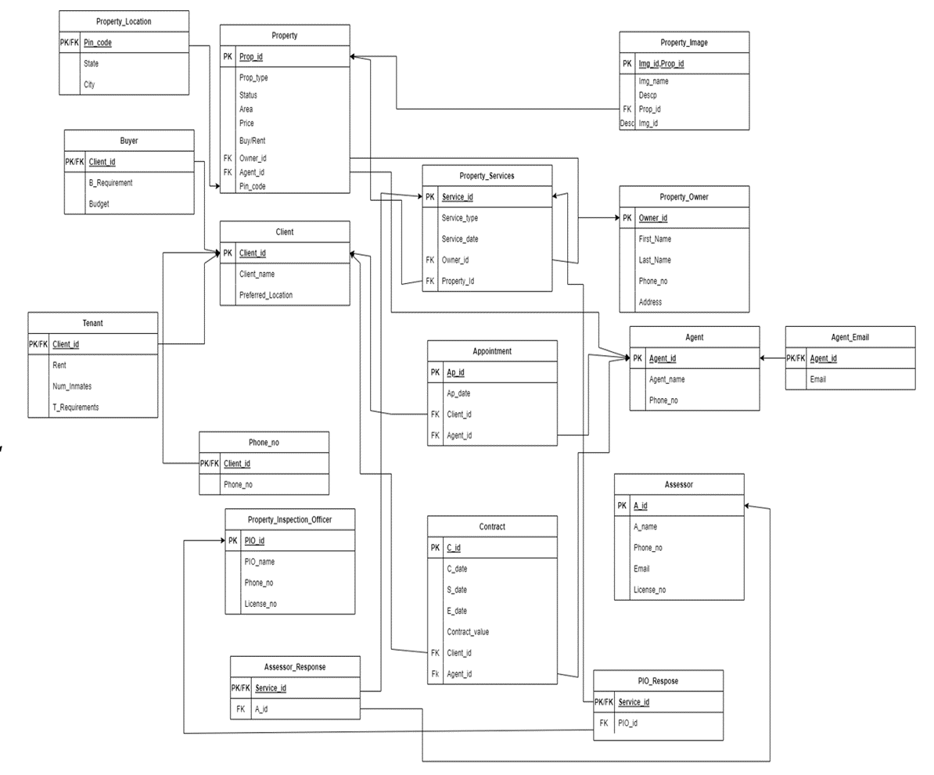
RELATIONAL SCHEMA AFTER NORMALIZATION

Slide 27
APPLICATION
TABLE CREATION
CREATE TABLE PROPERTY_OWNER
(
OWNER_ID INT PRIMARY KEY,
FIRST_NAME VARCHAR(20),
LAST_NAME VARCHAR(20),
PHONE_NO INT,
ADDRESS VARCHAR(100)
);

Slide 28
CREATE TABLE AGENT
(
AGENT_ID INT PRIMARY KEY,
AGENT_NAME VARCHAR(50),
PHONE_NO INT
);
CREATE TABLE AGENT_EMAIL
(
AGENT_ID INT,
EMAIL VARCHAR(100),
FOREIGN KEY(AGENT_ID) REFERENCES AGENT(AGENT_ID),
CONSTRAINT PK_AGENT_EMAIL PRIMARY KEY(AGENT_ID)
);

Slide 29
CREATE TABLE ASSESSOR
(
A_ID INT PRIMARY KEY,
A_NAME VARCHAR(30),
PHONE_NO INT,
EMAIL VARCHAR(100),
LICENSE_NO INT
);
CREATE TABLE PROPERTY_INSPECTION_OFFICER
(
PIO_ID INT PRIMARY KEY,
PIO_NAME VARCHAR(50),
PHONE_NO INT,
LICENSE_NO INT
);

Slide 30
CREATE TABLE CLIENT
( CLIENT_ID INT PRIMARY KEY,
CLIENT_NAME VARCHAR(50),
STATE VARCHAR(30),
CITY VARCHAR(30),
PIN_CODE INT,
PREFERRED_LOCATION VARCHAR(100)
);
CREATE TABLE BUYER
( CLIENT_ID INT,
B_REQUIREMENT VARCHAR(100),
BUDGET INT,
FOREIGN KEY(CLIENT_ID) REFERENCES CLIENT(CLIENT_ID),
CONSTRAINT PK_BUYER PRIMARY KEY(CLIENT_ID)
);

Slide 31
CREATE TABLE TENANT
( CLIENT_ID INT,
T_REQUIREMENT VARCHAR(100),
RENT INT,
NUM_INMATES INT,
FOREIGN KEY(CLIENT_ID) REFERENCES CLIENT(CLIENT_ID),
CONSTRAINT PK_TENANT PRIMARY KEY(CLIENT_ID)
);
CREATE TABLE C_PHONE_NO
(
CLIENT_ID INT,
PHONE_NO INT,
FOREIGN KEY(CLIENT_ID) REFERENCES CLIENT(CLIENT_ID),
CONSTRAINT PK_C_PHONE_NO PRIMARY KEY(CLIENT_ID)
);

Slide 32
CREATE TABLE PROPERTY
(
PROP_ID INT PRIMARY KEY,
PROP_TYPE VARCHAR(20),
STATUS VARCHAR(20),
AREA INT,
PRICE INT,
BUY_RENT VARCHAR(20),
ADDRESS VARCHAR(100),
OWNER_ID INT,
AGENT_ID INT,
FOREIGN KEY (OWNER_ID) REFERENCES PROPERTY_OWNER(OWNER_ID),
FOREIGN KEY (AGENT_ID) REFERENCES AGENT(AGENT_ID)
);

Slide 33
CREATE TABLE PROPERTY_SERVICES
(
SERVICE_ID INT PRIMARY KEY,
SERVICE_TYPE VARCHAR(20),
SERVICE_DATE DATE,
OWNER_ID INT,
PROPERTY_ID INT,
FOREIGN KEY (OWNER_ID) REFERENCES PROPERTY_OWNER(OWNER_ID),
FOREIGN KEY (PROPERTY_ID) REFERENCES PROPERTY(PROP_ID)
);

Slide 34
CREATE TABLE ASSESSOR_RESPONSE
(
SERVICE_ID INT,
A_ID INT,
FOREIGN KEY (SERVICE_ID) REFERENCES PROPERTY_SERVICES(SERVICE_ID),
FOREIGN KEY (A_ID) REFERENCES ASSESSOR(A_ID),
CONSTRAINT PK_AR PRIMARY KEY(SERVICE_ID)
);
CREATE TABLE PIO_RESPONSE
(
SERVICE_ID INT,
PIO_ID INT,
FOREIGN KEY (SERVICE_ID) REFERENCES PROPERTY_SERVICES(SERVICE_ID),
FOREIGN KEY (PIO_ID) REFERENCES PROPERTY_INSPECTION_OFFICER(PIO_ID),
CONSTRAINT PK_PIOR PRIMARY KEY(SERVICE_ID)
);

Slide 35
CREATE TABLE APPOINTMENT
(
AP_ID INT PRIMARY KEY,
AP_DATE DATE,
CLIENT_ID INT,
AGENT_ID INT,
FOREIGN KEY(CLIENT_ID) REFERENCES CLIENT(CLIENT_ID),
FOREIGN KEY (AGENT_ID) REFERENCES AGENT(AGENT_ID)
);

Slide 36
CREATE TABLE CONTRACT
(
C_ID INT PRIMARY KEY,
C_DATE DATE,
S_DATE DATE,
E_DATE DATE,
CONTRACT_VALUE INT,
CLIENT_ID INT,
AGENT_ID INT,
FOREIGN KEY(CLIENT_ID) REFERENCES CLIENT(CLIENT_ID),
FOREIGN KEY (AGENT_ID) REFERENCES AGENT(AGENT_ID)
);

Slide 37
CREATE TABLE PROPERTY_IMAGE
(
IMG_ID INT,
PROP_ID INT,
IMG_NAME VARCHAR(20),
DESCP VARCHAR(100),
FOREIGN KEY (PROP_ID) REFERENCES PROPERTY(PROP_ID),
CONSTRAINT PK_PROPERTY_IMAGE PRIMARY KEY(IMG_ID,PROP_ID)
);

Slide 38
DATA INSERTION
1.PROPERTY_INSPECTION_OFFICER
INSERT INTO PROPERTY_INSPECTION_OFFICER VALUES(3001,'THANEDAR',67890123458,1111772);
INSERT INTO PROPERTY_INSPECTION_OFFICER VALUES(3002,'AMIT',6789012773,1111896);
INSERT INTO PROPERTY_INSPECTION_OFFICER VALUES(3003,'SAGAR',88890123458,111772);
INSERT INTO PROPERTY_INSPECTION_OFFICER VALUES(3004,'ARJUN',98890123458,1111772);
2.ASSESSOR
INSERT INTO ASSESSOR VALUES(3501,'RANA PRATAP',7786779900,'RP@GMAIL.COM',22461);
INSERT INTO ASSESSOR VALUES(3502,'AMRESH',7786779900,'AM@GMAIL.COM',22572);
INSERT INTO ASSESSOR VALUES(3503,'SHUBAM',8786779900,'SH@GMAIL.COM',22811);
INSERT INTO ASSESSOR VALUES(3504,'GAUTAM',9786779900,'GA@GMAIL.COM',22922);

Slide 39
3.ASSESSOR_RESPONSE
INSERT INTO ASSESSOR_RESPONSE VALUES(4001,3501);
INSERT INTO ASSESSOR_RESPONSE VALUES(4003,3501);
INSERT INTO ASSESSOR_RESPONSE VALUES(4004,3502);
INSERT INTO ASSESSOR_RESPONSE VALUES(4006,3504);
4.PIO_RESPONSE
INSERT INTO PIO_RESPONSE VALUES(4002,3002);
INSERT INTO PIO_RESPONSE VALUES(4005,3003);
INSERT INTO PIO_RESPONSE VALUES(4007,3002);
INSERT INTO PIO_RESPONSE VALUES(4008,3004);

Slide 40
5.PROPERTY_SERVICES
INSERT INTO PROPERTY_SERVICES VALUES(4001,'ASSESS','28-APR-20',7001,1001);
INSERT INTO PROPERTY_SERVICES VALUES(4002,'INSPECT','02-MAY-20',7001,1002);
INSERT INTO PROPERTY_SERVICES VALUES(4003,'ASSESS','23-MAY-20',7001,1005);
INSERT INTO PROPERTY_SERVICES VALUES(4004,'ASSESS','11-MAR-20',7001,1003);
INSERT INTO PROPERTY_SERVICES VALUES(4005,'INSPECT','08-MAY-20',7001,1001);
INSERT INTO PROPERTY_SERVICES VALUES(4006,'ASSESS','24-APR-20',7001,1002);
INSERT INTO PROPERTY_SERVICES VALUES(4007,'INSPECT','18-MAY-20',7001,1007);
INSERT INTO PROPERTY_SERVICES VALUES(4008,'INSPECT','29-MAR-20',7001,1008);

Slide 41
6.PROPERTY_IMAGE
INSERT INTO PROPERTY_IMAGE VALUES(9001,1001,'I1.PNG','FRONT VIEW');
INSERT INTO PROPERTY_IMAGE VALUES(9002,1002,'I2.PNG','SIDE VIEW');
INSERT INTO PROPERTY_IMAGE VALUES(9003,1001,'I3.PNG','BACK VIEW');
INSERT INTO PROPERTY_IMAGE VALUES(9004,1003,'I4.PNG','SIDE VIEW');
INSERT INTO PROPERTY_IMAGE VALUES(9005,1004,'I5.PNG','FRONT VIEW');
INSERT INTO PROPERTY_IMAGE VALUES(9006,1005,'I6.PNG','SIDE VIEW');
7.AGENT_EMAIL
INSERT INTO AGENT_EMAIL VALUES(8001,'PRAKASH123@GMAIL.COM');
INSERT INTO AGENT_EMAIL VALUES(8001,'PRAKASH486@GMAIL.COM');
INSERT INTO AGENT_EMAIL VALUES(8002,'SAHAY193@GMAIL.COM');
INSERT INTO AGENT_EMAIL VALUES(8003,'RISHI113@GMAIL.COM');
INSERT INTO AGENT_EMAIL VALUES(8003,'RISHU23@GMAIL.COM');
INSERT INTO AGENT_EMAIL VALUES(8004,'AGASTYA_123@GMAIL.COM');

Slide 42
8.CONTRACT
INSERT INTO CONTRACT VALUES(6001,'02-MAY-20',NULL,NULL,20000000,2001,8001);
INSERT INTO CONTRACT VALUES(6002,'04-SEP-21',NULL,NULL,5000000,2001,8001);
INSERT INTO CONTRACT VALUES(6003,'12-AUG-22',NULL,NULL,8000000,2001,8001);
INSERT INTO CONTRACT VALUES(6004,'05-JUL-21','24-JUL-21','21-JUL-24',35000,2001,8001);
INSERT INTO CONTRACT VALUES(6005,'19-FEB-20','01-MAR-20','04-MAR-24',200000,2001,8001);
INSERT INTO CONTRACT VALUES(6006,'21-JAN-22','01-FEB-22','16-SEP-26',600000,2001,8001);
9.APPOINTMENT
INSERT INTO APPOINTMENT VALUES(5001,'16-MAR-2020',2001,8001);
INSERT INTO APPOINTMENT VALUES(5002,'22-AUG-2020',2002,8001);
INSERT INTO APPOINTMENT VALUES(5003,'31-JUL-2022',2004,8002);
INSERT INTO APPOINTMENT VALUES(5004,'01-JUN-2021',2007,8003);
INSERT INTO APPOINTMENT VALUES(5005,'10-FEB-2020',2009,8004);
INSERT INTO APPOINTMENT VALUES(5006,'10-JAN-2022',2010,8004);

Slide 43
10.PROPERTY_OWNER
INSERT INTO PROPERTY_OWNER VALUES(7001,'PRANAV','GHANTE',9822934039,'GM ROAD PUNE');
INSERT INTO PROPERTY_OWNER VALUES(7002,'ISHAN','GUPTA',7722934039,'HK STREET WARANGAL');
INSERT INTO PROPERTY_OWNER VALUES(7003,'ARYAN','SINGH',9856934039,'HITECH CITY HYDERABAD');
INSERT INTO PROPERTY_OWNER VALUES(7004,'OM','KADAM',9822956739,'FORT MUMBAI');
INSERT INTO PROPERTY_OWNER VALUES(7005,'ADHIRAJ','PATEL',6782934039,'GM ROAD DELHI');
INSERT INTO PROPERTY_OWNER VALUES(7006,'AASHISH','RAMPAL',9567934039,'BANDRA MUMBAI');
11.BUYER
INSERT INTO BUYER VALUES(2001, 'Industrial', 70000000);
INSERT INTO BUYER VALUES(2002, 'Commercial', 20000000);
INSERT INTO BUYER VALUES(2003, 'Residential',50000000);
INSERT INTO BUYER VALUES(2004, 'Commercial', 15000000);
INSERT INTO BUYER VALUES(2005, 'Residential',6500000);

Slide 44
12.C_PHONE_NO
INSERT INTO C_PHONE_NO VALUES(2001, 7495801192);
INSERT INTO C_PHONE_NO VALUES(2001, 7498611258);
INSERT INTO C_PHONE_NO VALUES(2002, 8488615995);
INSERT INTO C_PHONE_NO VALUES(2003, 9199940159);
INSERT INTO C_PHONE_NO VALUES(2004, 8655211596);
INSERT INTO C_PHONE_NO VALUES(2005, 6418611959);
INSERT INTO C_PHONE_NO VALUES(2005, 7477710001);
INSERT INTO C_PHONE_NO VALUES(2006, 8166652194);
INSERT INTO C_PHONE_NO VALUES(2007, 7915620118);
INSERT INTO C_PHONE_NO VALUES(2008, 8611940216);
INSERT INTO C_PHONE_NO VALUES(2009, 9495064364);
INSERT INTO C_PHONE_NO VALUES(2009, 9933810506);
INSERT INTO C_PHONE_NO VALUES(2010, 7895463222);

Slide 45
13.TENANT
INSERT INTO TENANT VALUES(2006, 200000, 'Commercial', NULL);
INSERT INTO TENANT VALUES(2007, 40000, 'Residential', 4);
INSERT INTO TENANT VALUES(2008, 80000, 'Residential', 1);
INSERT INTO TENANT VALUES(2009, 350000, 'Commercial', NULL);
INSERT INTO TENANT VALUES(2010, 100000, 'Residential', 2);
14.AGENT
INSERT INTO AGENT VALUES(8001, 'Prakash', 8488619921);
INSERT INTO AGENT VALUES(8002, 'Sahay', 9999911111);
INSERT INTO AGENT VALUES(8003, 'Rishabh', 6869485594);
INSERT INTO AGENT VALUES(8004, 'Agastya', 7411978223);

Slide 46
15.PROPERTY
INSERT INTO PROPERTY VALUES(1001, 'Commercial', 'NOT AVAILABLE', 14000, 100000000, 'FOR SALE', 7001, 8002, 403001);
INSERT INTO PROPERTY VALUES(1002, 'Industrial', 'AVAILABLE', 130000, 70000000, 'FOR SALE', 7001, 8004, 474002);
INSERT INTO PROPERTY VALUES(1003, 'Residential(1 BHK)', 'NOT AVAILABLE', 800, 15000000, 'ON RENT', 7003, 8001, 206002);
INSERT INTO PROPERTY VALUES(1004, 'Residential(3 BHK)', 'NOT AVAILABLE', 1000, 80000, 'ON RENT', 7005, 8002, 250001);
INSERT INTO PROPERTY VALUES(1005, 'Commercial', 'AVAILABLE', 15000, 120000000, 'FOR SALE', 7004, 8003, 400001);
INSERT INTO PROPERTY VALUES(1006, 'Industrial', 'NOT AVAILABLE', 150000, 100000000, 'FOR SALE', 7006, 8003, 300018);
INSERT INTO PROPERTY VALUES(1007, 'Residential(Villa)', 'NOT AVAILABLE', 1600, 10000000, 'FOR SALE', 7006, 8003, 500001);
INSERT INTO PROPERTY VALUES(1008, 'Commercial', 'NOT AVAILABLE', 17000, 9000000, 'ON RENT', 7002, 8003, 506001);
INSERT INTO PROPERTY VALUES(1009, 'Residential', 'AVAILABLE', 1200, 5000000, 'ON RENT', 7002, 8001, 700001);
INSERT INTO PROPERTY VALUES(1010, 'Commercial', 'AVAILABLE', 22000, 150000000, 'FOR SALE', 7003, 8003, 248001);
INSERT INTO PROPERTY VALUES(1011, 'Residential', 'AVAILABLE', 1700, 8500000, 'FOR SALE', 7005, 8004, 400001);
INSERT INTO PROPERTY VALUES(1012, 'Residential', 'AVAILABLE', 2200, 25000, 'ON RENT', 7006, 8001, 500001);

Slide 47
16.PROPERTY_LOCATION
INSERT INTO PROPERTY_LOCATION VALUES(403001, 'Goa', 'Panji');
INSERT INTO PROPERTY_LOCATION VALUES(474002, 'Madhya Pradesh', 'Gwalior');
INSERT INTO PROPERTY_LOCATION VALUES(206002, 'Uttar Pradesh', 'Etawah');
INSERT INTO PROPERTY_LOCATION VALUES(250001, 'Uttar Pradesh', 'Meerut');
INSERT INTO PROPERTY_LOCATION VALUES(400001, 'Maharashtra', 'Mumbai');
INSERT INTO PROPERTY_LOCATION VALUES(30018, 'Gujarat', 'Vadodara');
INSERT INTO PROPERTY_LOCATION VALUES(500001, 'Telangana', 'Hyderabad');
INSERT INTO PROPERTY_LOCATION VALUES(506001, 'Telangana', 'Warangal');
INSERT INTO PROPERTY_LOCATION VALUES(700001, 'West Bengal', 'Kolkata');
INSERT INTO PROPERTY_LOCATION VALUES(248001, 'Uttarakhand', 'Dehradun');

Slide 48
17.CLIENT
INSERT INTO CLIENT VALUES(2001, 'Ishaan' , 'Mumbai');
INSERT INTO CLIENT VALUES(2002, 'Mahesh' , 'Gwalior');
INSERT INTO CLIENT VALUES(2003, 'Kunal' , 'Kolkata');
INSERT INTO CLIENT VALUES(2004, 'Aman' , 'Etawah');
INSERT INTO CLIENT VALUES(2005, 'Mohit' , 'Vadodara');
INSERT INTO CLIENT VALUES(2006, 'Sanket' , 'Mumbai');
INSERT INTO CLIENT VALUES(2007, 'Dibya' , 'Hyderabad');
INSERT INTO CLIENT VALUES(2008, 'Steve' , 'Warangal');
INSERT INTO CLIENT VALUES(2009, 'Bhavana' , 'Delhi');
INSERT INTO CLIENT VALUES(2010, 'Aakanksha', 'Panji');

Slide 49
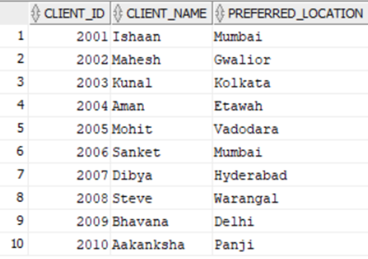
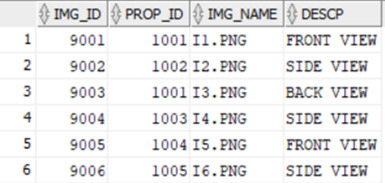
SELECT * FROM CLIENT;
SELECT * FROM PROPERTY_IMAGE;

Slide 50
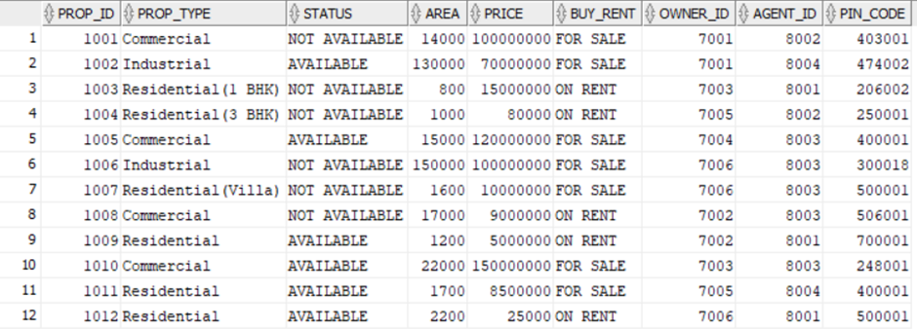
SELECT * FROM PROPERTY;

Slide 51
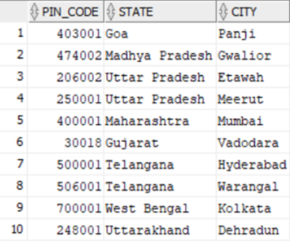
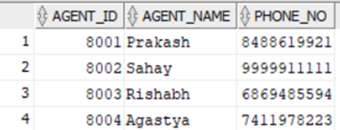
SELECT * FROM PROPERTY_LOCATION;
SELECT * FROM AGENT;

Slide 52
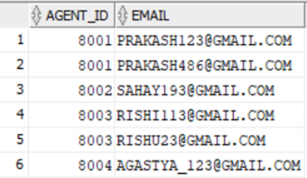
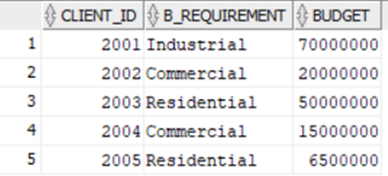
SELECT * FROM AGENT_EMAIL;
SELECT * FROM BUYER;

Slide 53
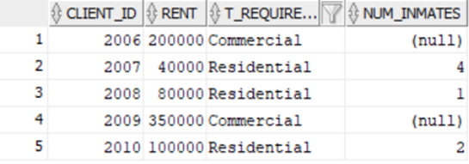
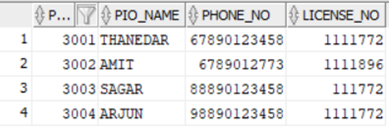
SELECT * FROM TENANT;
SELECT * FROM PROPERTY_INSPECTION_OFFICER;

Slide 54
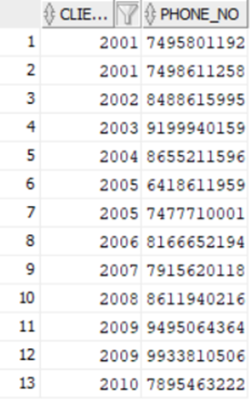
SELECT * FROM C_PHONE_NO;

Slide 55
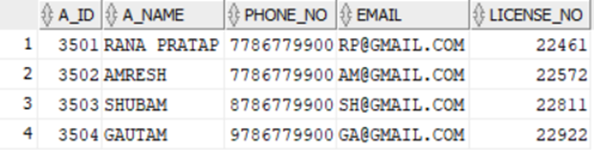
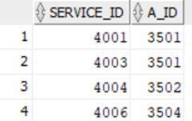
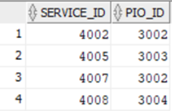
SELECT * FROM ASSESSOR;
SELECT * FROM ASSESSOR_RESPONSE;
SELECT * FROM PIO_RESPONSE;

Slide 56
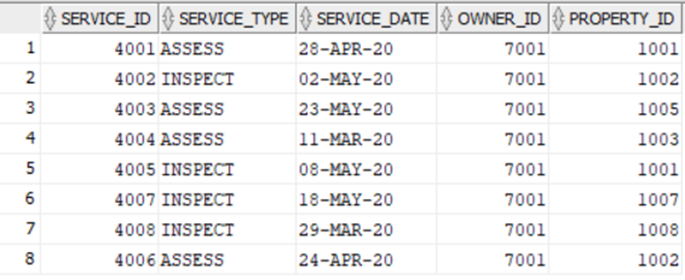
SELECT * FROM PROPERTY_SERVICES;

Slide 57
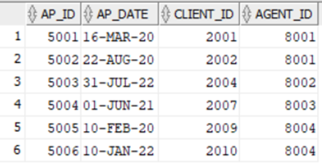
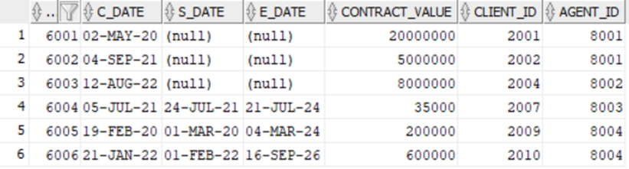
SELECT * FROM APPOINTMENT;
SELECT * FROM CONTRACT;

Slide 58
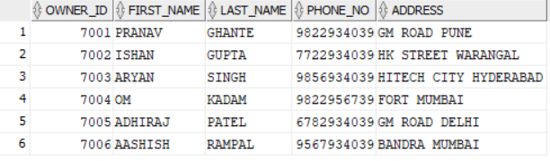
SELECT * FROM PROPERTY_OWNER;

Slide 59
PL-SQL TRIGGER FOR INSERTION UPDATION AND DELETION ON PROPERTY TABLE
CREATE OR REPLACE TRIGGER PROPERRTY_TRIGGER
BEFORE INSERT OR UPDATE OR DELETE ON PROPERTY
FOR EACH ROW
ENABLE
BEGIN
IF INSERTING THEN
DBMS_OUTPUT.PUT_LINE('THE DATA INSERTED IS AVAILABLE FOR '||:NEW.BUY_RENT);
ELSIF UPDATING THEN
DBMS_OUTPUT.PUT_LINE('THE STATUS IS UPDATED FROM '||:OLD.STATUS||' TO '||:NEW.STATUS);
ELSIF DELETING THEN
DBMS_OUTPUT.PUT_LINE('THE PROPERTY '||:NEW.PROP_ID||' IS DELETED');
END IF;
END;

Slide 60


PL-SQL TRIGGER FOR INSERTION UPDATION AND DELETION ON PROPERTY TABLE
INSERT INTO PROPERTY VALUES(1011, 'Residential', 'AVAILABLE', 1700, 8500000, 'SALE', 7005, 8004, 400001);
UPDATE PROPERTY SET STATUS='NOT AVAILABLE' WHERE PROP_ID=1012;
Delete from Property where prop_id=1011;

Slide 61
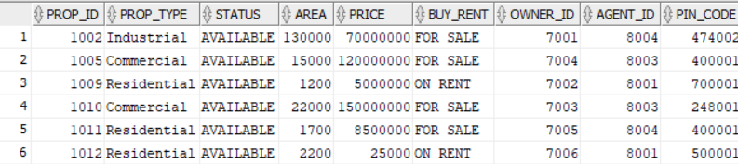

SQL QUERIES FOR TESTING DATABASE
1.GIVE THE INFORMATION OF ALL PROPERTIES WHICH ARE AVAILABLE?
SELECT * FROM PROPERTY
WHERE STATUS='AVAILABLE’;
2. LIST ALL THE PROPERTIES WHICH ARE IN MUMBAI?
SELECT P.PROP_ID,P.PROP_TYPE,P.STATUS
FROM PROPERTY P
JOIN PROPERTY_LOCATION PL
ON P.PIN_CODE=PL.PIN_CODE
WHERE PL.CITY='Mumbai';

Slide 62
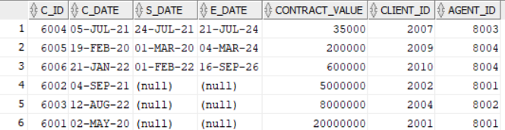
SQL QUERIES FOR TESTING DATABASE
3. Sort the prices of contract values in the Contract table?
SELECT * FROM CONTRACT
ORDER BY CONTRACT_VALUE;

Slide 63

SQL QUERIES FOR TESTING DATABASE
4. Name of Buyer with Industrial Requirements?
SELECT C.CLIENT_NAME
FROM CLIENT C
JOIN BUYER B
ON C.CLIENT_ID=B.CLIENT_ID
WHERE B.B_REQUIREMENT='Industrial’;
OUTPUT

